Slide 1
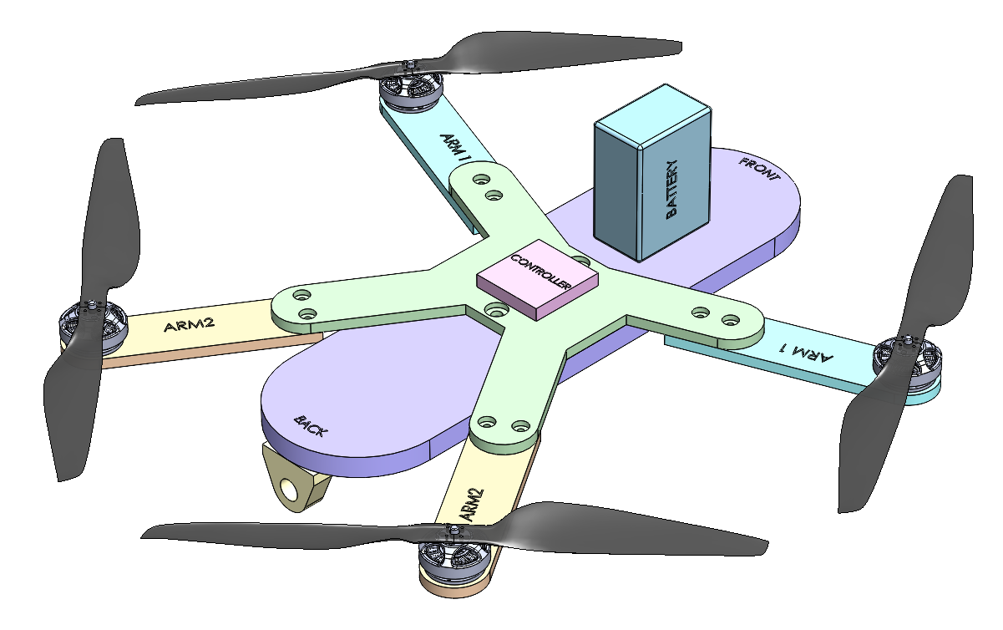
Isometric View of Drone with Perspective

Slide 2
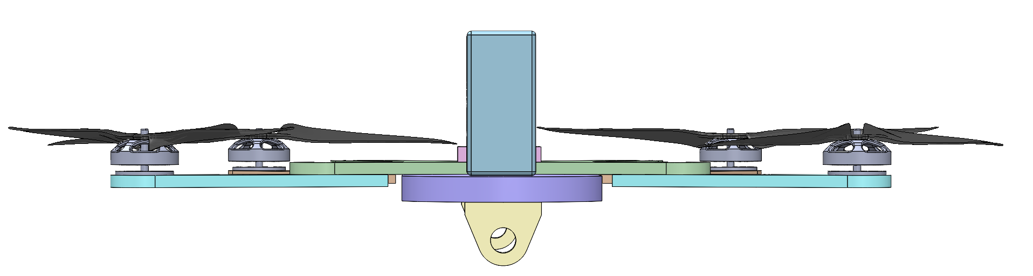
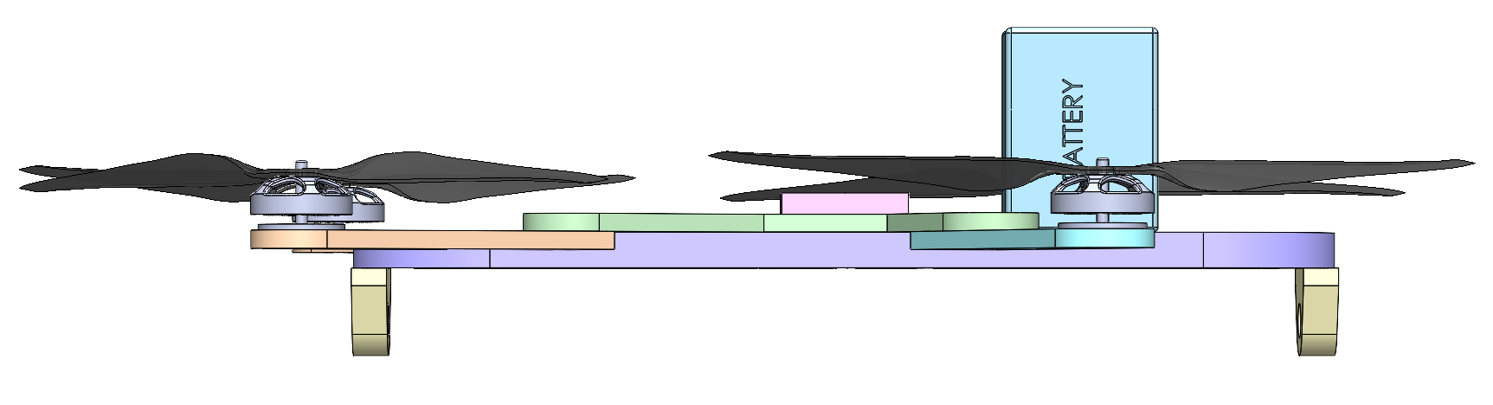
Front and Side View of Drone with Perspective
Front View
Right View

Slide 3
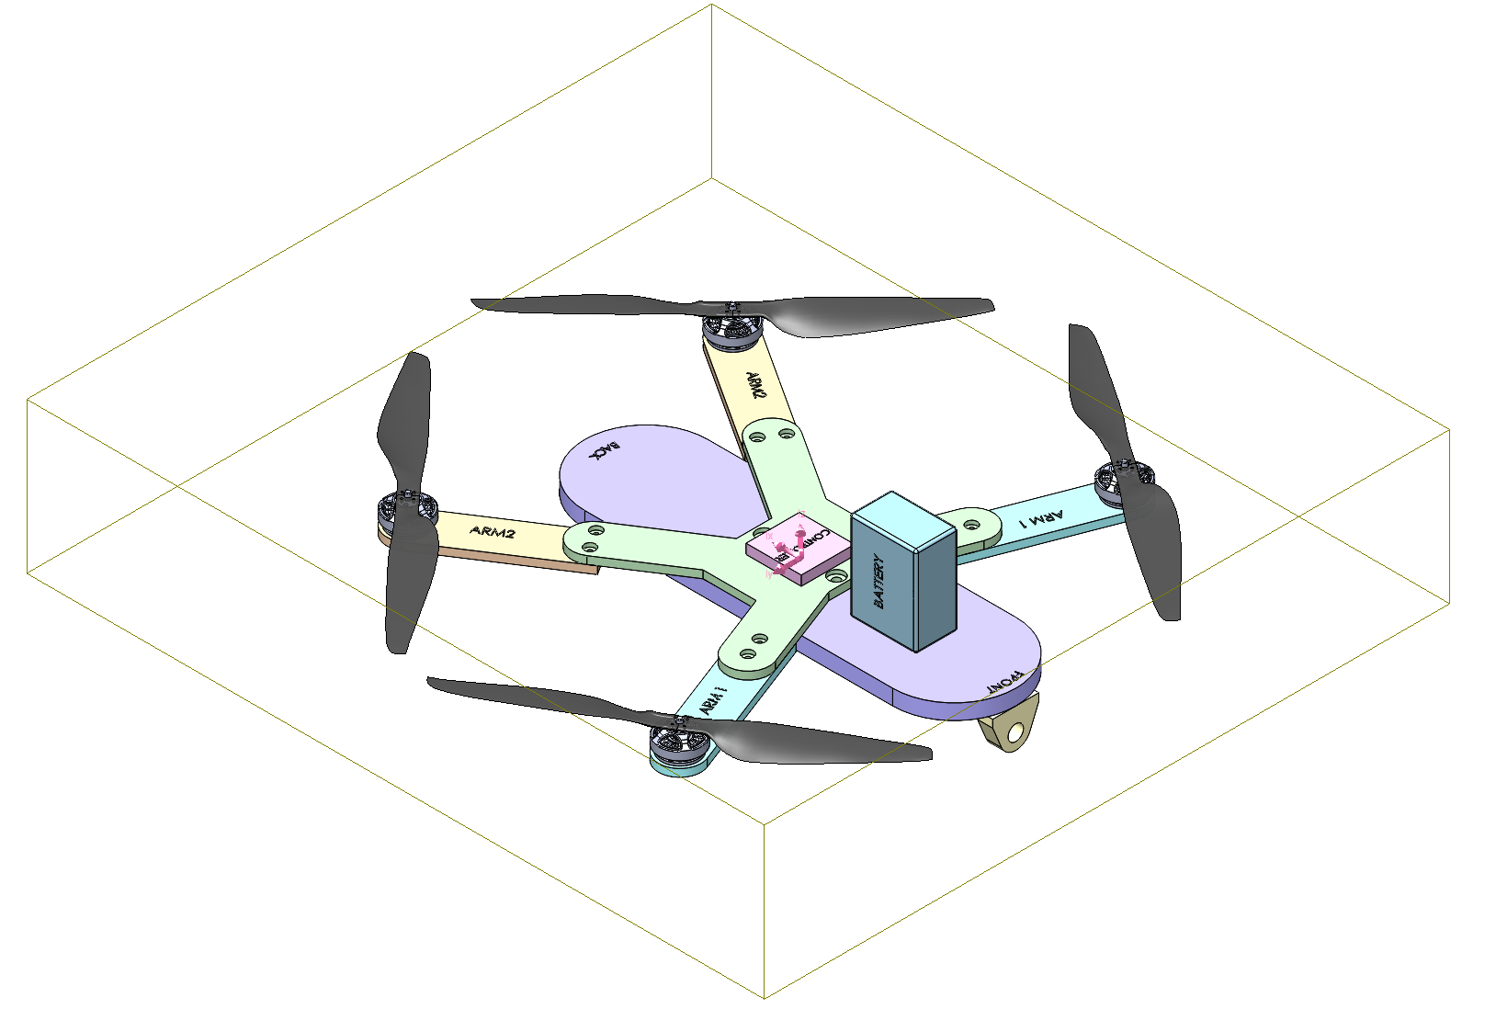
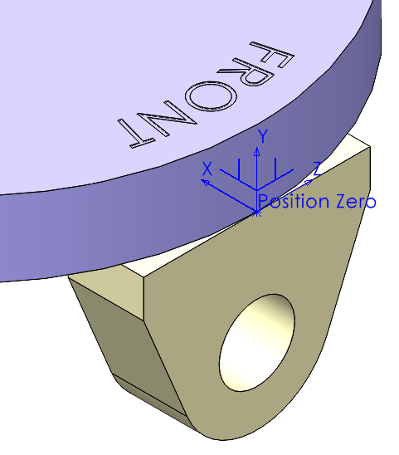
Mass Properties with Center of Mass
Mass properties of Final Drone Assembly
(Hand Calculation Separate)
Mass = 1.5331 kilograms
Volume = 55.8851 cubic inches
Surface area = 484.4744 square inches
Center of mass from Front Base as Position Zero
X = 6.9631 in
Y = 0.6950 in
Z = 0.0000 in
Center of Mass

Slide 4
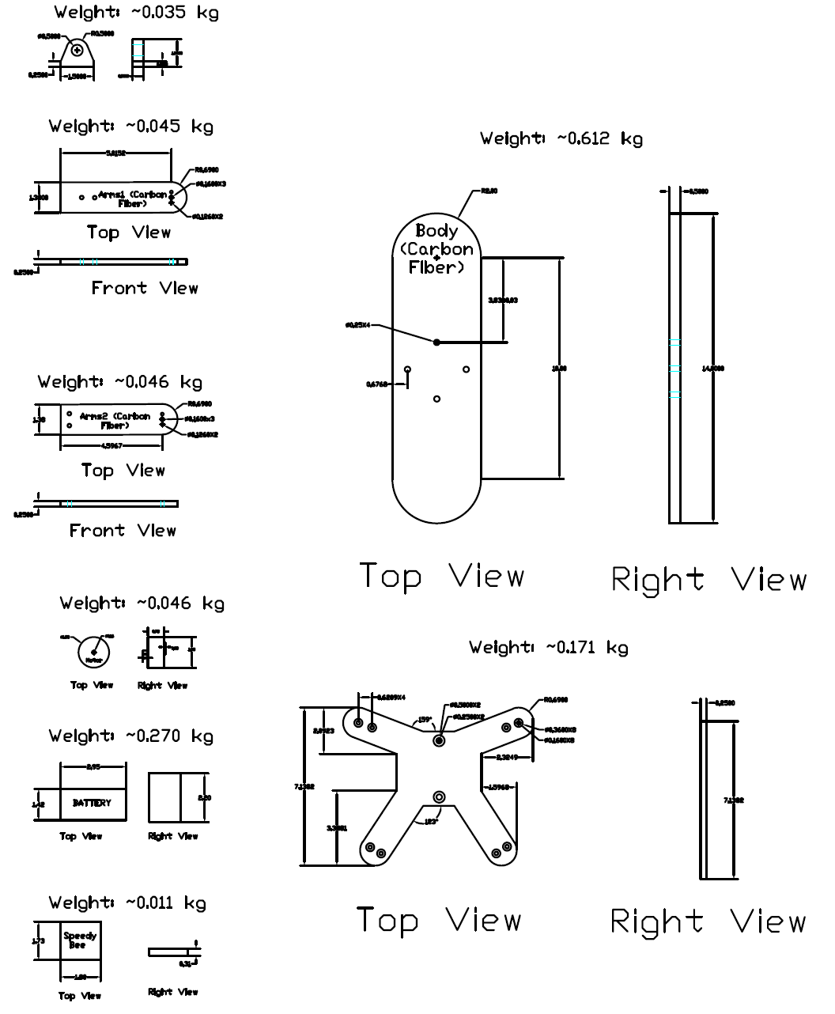
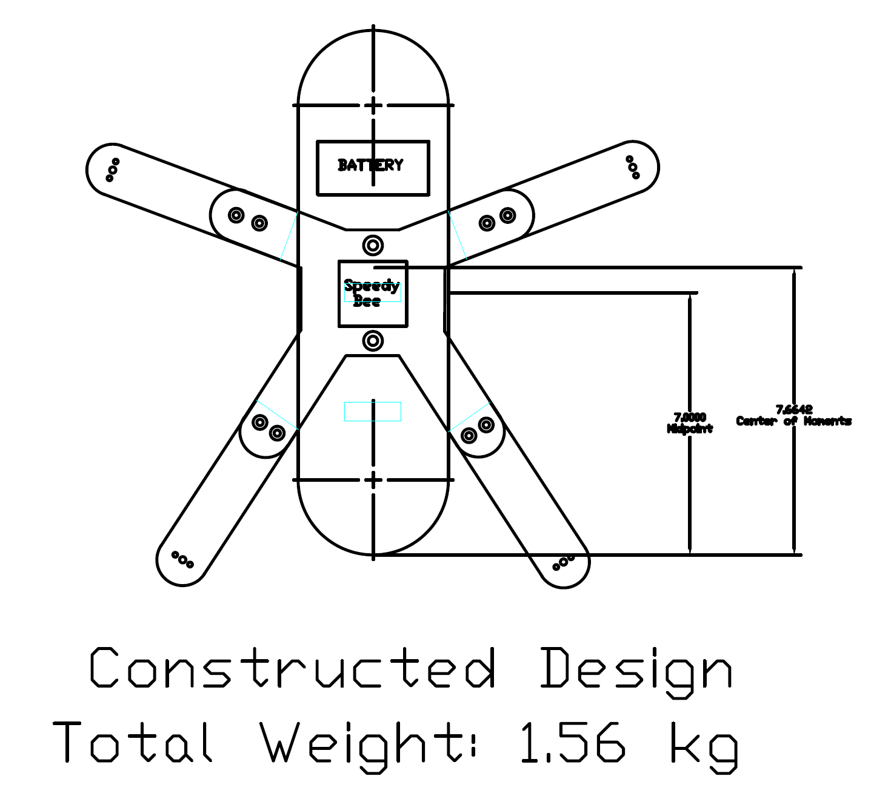
Initial CAD Design

